Slide 1
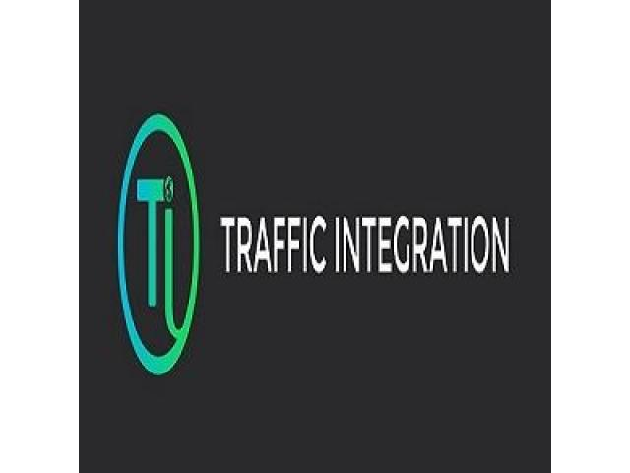
Digital Marketing Company in Coimbatore

Slide 2
CHAPTERS COVERED
Digital Marketing
SEO
SEM
SMM
Content Marketing
Email Marketing
Web Design

Slide 3
SYLLABUS CHAPTER - 1
Introduction to Digital Marketing
What is marketing? What is Digital Marketing? Benefits of Digital Marketing Digital marketing platforms and Strategy Comparing Digital with Traditional Marketing Latest Digital marketing trends Case Studies of Digital Campaigns Website Designing with WordPress.

Slide 4
SYLLABUS CHAPTER - 2
Search Engine Optimization
How the search engine works? Google Algorithms Google Results Page Social Bookmarking Link Building Resources Local SEO what is Local SEO? Importance of Local SEO Submission to Google My Business

Slide 5
SYLLABUS CHAPTER - 3
Introduction to Keyword Research: Types of Keywords Keyword Research Methodology Business Analysis & Categorization Google Keyword Planner New Keyword Ideas Competition Analysis Finalizing the Keywords List On page Optimization

Slide 6
SYLLABUS CHAPTER - 4
Introduction to Social Media Marketing
All SEM
What is SEM?
The complete guide to PPC
How to guides: SEM
SEM Google ad words
Bing Ads

Slide 7
SYLLABUS CHAPTER - 5
Content Marketing
Email Marketing
Web Design

Slide 8
Digital marketing Company in Coimbatore
So, Traffic Integration is one of the promising digital marketing companies in Coimbatore. From a service primarily based web site or an e-commerce portal to online promotions and selling, we offer all digital selling services in a very platter.

Slide 9
Contact Us
52/1, Kongu Nagar, Ramanatha Puram, Coimbatore.
(+91) 9791804290
info@trafficintegration.com

